Slide 1
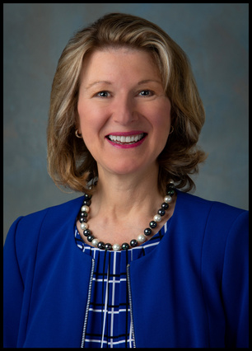
Facing the Future Together
In-Person!
We're Back Live
Please Join Us!
Monday, September 19, 2022
8:00 AM - 2:00 PM
American Family Insurance Headquarters Auditorium
6000 American Parkway, Madison, WI 53783
featuring
Postmaster Louis DeJoy's Video Message
and Keynote Speaker
Judy de Torok, USPS VP Corporate Affairs

Slide 2
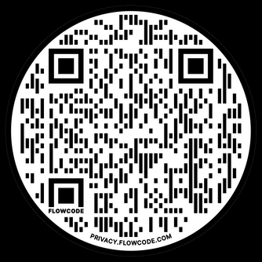
Greater Madison PCC
PO Box 14285
Madison WI 53708-0285
Presort First-Class
Postage & Fees Paid
USPS
Permit No. G-10
National PCC Day
September 19, 2022
8:00 AM - 2:00 PM CST
Scan the QR Code to Register!
www.madisonpcc.com
Get Connected and Grow!

Slide 3
Greater Madison Area
Postal Customer Council
Greater Madison PCC
PO Box 14285
Madison WI 53708-0285
Presort First-Class
Postage & Fees Paid
USPS
Permit No. G-10
National PCC Day
September 19, 2022
8:00 AM - 2:00 PM CST
Scan the QR Code to Register!
www.madisonpcc.com
Get Connected and Grow!

